Slide 1
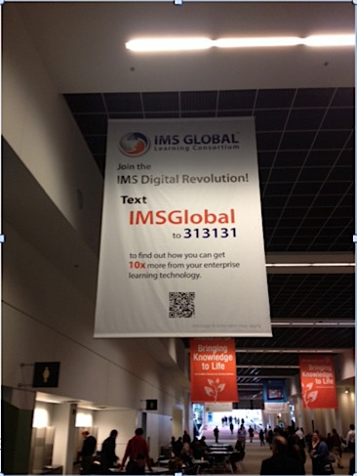
Encouraging the Proliferation of Learning Apps Based on Open Standards
Rob Abel, Ed.D.
Chief Executive Officer
rabel@imsglobal.org
http://www.imsglobal.org/
follow: @LearningImpact
Blog: http://www.imsglobal.org/blog

Slide 2
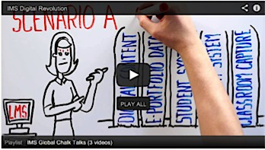
IMS Revolution Chalk Talk http://www.imsglobal.org/imsrevolution.html

Slide 3
An Open Foundation that Enables Seamless, Agile & Data-Rich Innovation
“Interoperable Learning Network” standards (IMS)
Just as W3C standards make interoperable exchange of text & graphics over the Internet easy, the IMS standards make exchange of information among educational applications easy.
World Wide Web standards (W3C)
Internet standards (IETF)

Slide 4
Course content
Ancillary content
e-textbooks
Adaptive tutors
Collaboration tools
Authoring tools
Social learning apps
Badging tools
Specialty course tools
Learning Management Systems (LMS)
Portals
Gaming/simulation environments
Learning tools or content providing tool hosting (e.g. e-book platform)
Learning
environments
Learning
tools/content
IMS open standards
Content exchange
Seamless, multipoint deep integration
User authorization
Educational context info
Outcomes/usage data
Student Information System (SIS)
Timetabling/scheduling
Other enterprise systems related to learning
e-Portfolio
Classroom/lecture capture
Assessment systems
Library resources
Digital video management
Enterprise
systems
Other traditionally isolated academic applications

Slide 5
10x to 100x improvement in time & cost of integration
With a much more seamless user experience!

Slide 6



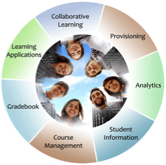


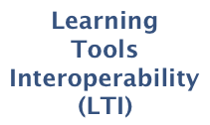


IMS Digital Learning Services Standards

Slide 7


A new era in education industry efficiency, innovation and collaboration. . .

Slide 8
IMS Progress - Stats:
IMS up to 220 member organizations (+40 in last 12 months, +170 in last 7 years)
> 200 conformance certifications for software (> 40 1st half 2013)
> 13000 digital learning resources (Common Cartridges) tested in 2012
IMS web community > 21000
Record attendance (336) IMS Learning Impact 2013
More stuff here: http://www.imsglobal.org/imsglobal2012annualReport.pdf

Slide 9
A Healthy, Vibrant, Open Market

Slide 10
“Moving from ‘Users’ to ‘Choosers’” -- Patrick Laughran, CIO Framingham State University

Slide 11
Student
Performance

Slide 12
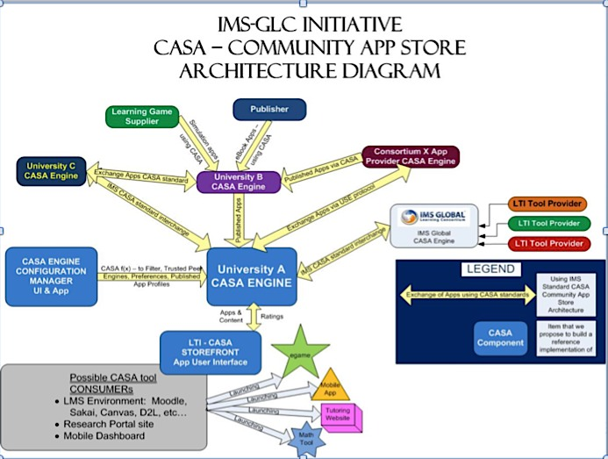

Slide 13
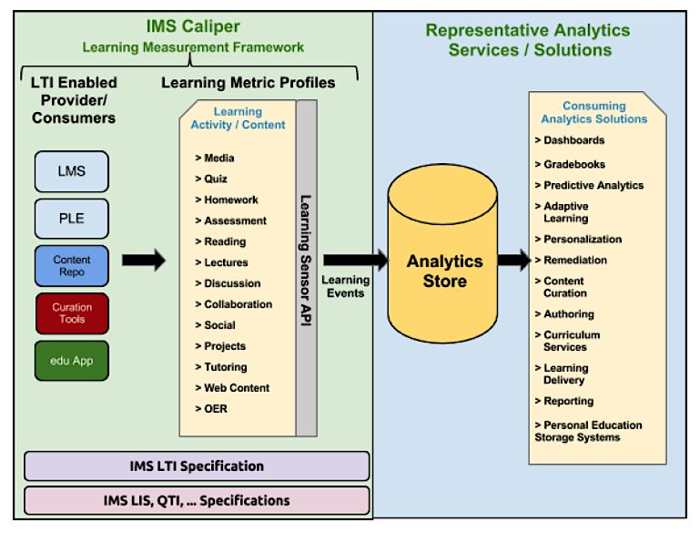
IMS Learning Analytics Initiative

Slide 15
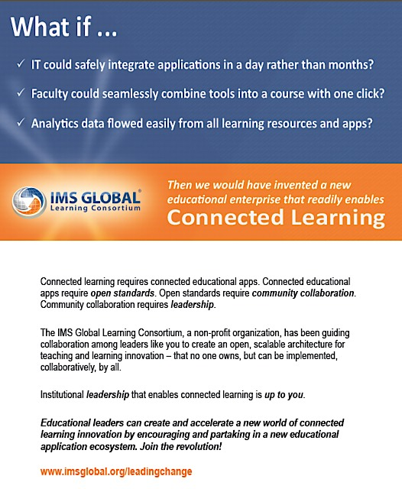
New IMS connected learning app community to be
announced at EDUCAUSE 2013!!
Including the inaugural connected learning app challenge leading up to IMS Learning Impact 2014, May in New Orleans

Slide 16
The Big Picture of the Present

Slide 17
IMS Core Constituency
IMS has historically been solidly centered on the Campus Enterprise Learning Management System
Content Packaging -> Common Cartridge
Enterprise - >Learner Information Service
QTI
Learning Tools Interoperability

Slide 18
Rising Publisher Influence
Common Cartridge was based on “demands” from publishers for a universal content standard for import
Interestingly becoming more of an LMS to LMS exchange format and enabler for Open Educational Resourses

Slide 19
Publishers and LTI
LTI allowed the publishers to host content behind an authenticated link instead of sending around multi-gigabyte ZIP files
Publishers did not need to worry about losing their high-value content if the ZIP file “escaped”

Slide 20
Enhanced eBooks
It was a small step to move from course content intended to be imported into an LMS to an iBooks-like eBook with interactive elements, tracked activities an other analytic data

Slide 21
Where does this end up?
Students will have an eBook reader on a mobile device and be using their textbooks before there course even exists on their campus LMS.
The LMS is no longer the only starting point for the user experience

Slide 23
Looking at Learning Tools Interoperability

Slide 24
Overview
IMS LTI 1.1
Focused on the tool having its little corner of the LMS – cannot escape its boundaries
IMS LTI 2.0
Increasingly the LMS and external tool are peers with the external tool with extensive tool-oriented services (Building Block or PowerLink)

Slide 25
IMS LTI 1.1 and Mobile
We can create deep links from an LMS to an LTI-aware mobile application
Account provisioning
Session provisioning
Deep linking
Extensive tracking within the mobile application
Simple grade return to the LMS via LTI

Slide 26
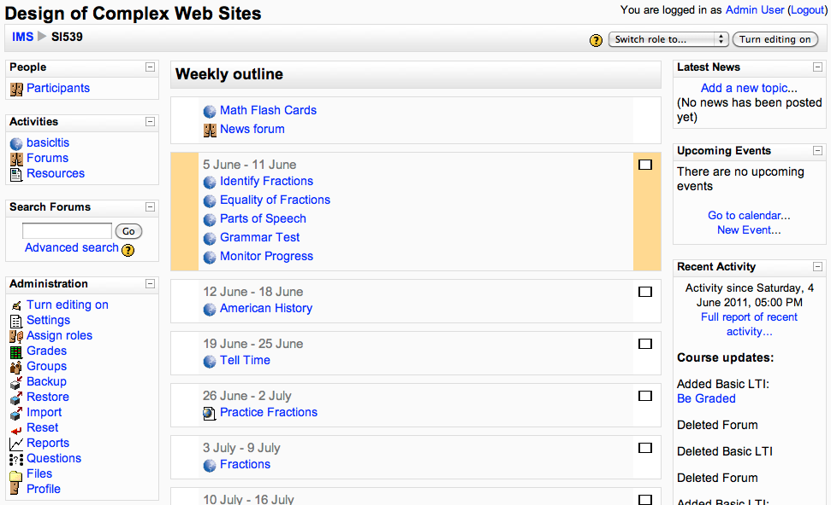

Slide 27
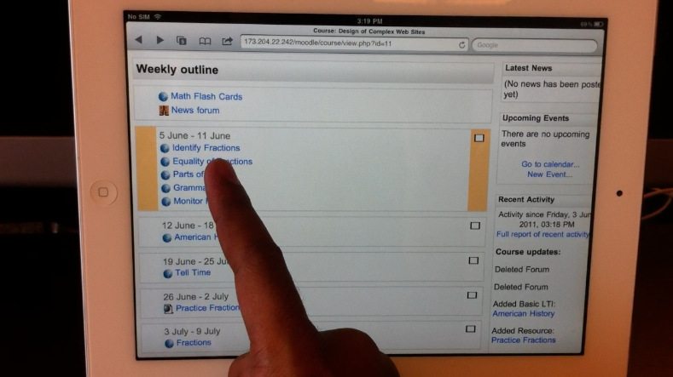
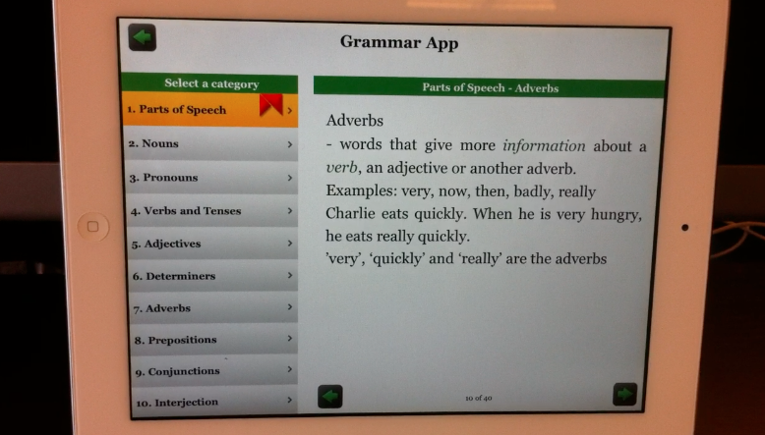
iPad Launch
Video Demo
http://www.vimeo.com/24699223

Slide 28
I
P
A
D
S
a
f
a
r
i
Moodle Page
Click LTI Link
Intermediate System

Slide 29
I
P
A
D
S
a
f
a
r
i
LTI Launch to Browser
Browser Posts LTI Launch
Intermediate System

Slide 30
I
P
A
D
S
a
f
a
r
i
Intermediate System
Provision user, course, role, session.
Redirect ttl://grammar/lesson?sess=123

Slide 31
I
P
A
D
G
r
a
m
m
a
r
Intermediate System
Provision user, course, role, session.
Redirect ttl://grammar/lesson?sess=123
iPad Switches to Grammar App

Slide 32
I
P
A
D
G
r
a
m
m
a
r
Intermediate Sys.
Provision user, course, role, session.
Redirect ttl://grammar/lesson?sess=123
Tracking
Proprietary
iPad Switches to Grammar App

Slide 33
I
P
A
D
G
r
a
m
m
a
r
LTI 1.1 Outcomes
Intermediate Sys
Provision user, course, role, session.
Redirect ttl://grammar/lesson?sess=123
Tracking
Proprietary
iPad Switches to Grammar App

Slide 34
Lessons from LTI 1.1
A single extremely limited launch and grade service turns out to enable a surprisingly rich application ecosystem
Built trust in accepting web service requests from “external tools” – security approach validated
Both the LMS vendors and Tool Vendors were hooked

Slide 35
Some LTI 1.1 Extensions
Automatical tool installation – Canvas
Roster and Settings service – Sakai, Atutor, SPV Software
Group Service – SPV Software
Installing a whole hierarcjhy of LTI Tools – Blackboard xpLor
Manyrich services - Canvas

Slide 36
Tool Provider Pain Points
Extensions are great but they are all different
Data format – XML, www-form-encoded, JSON
Security – OAuth Body Hash, PKI, Basic Auth
Model – RPC-Style or REST Style
Tool providers starting to build massive case statements and tracking each LMS services separately.

Slide 37
IMS LTI 2.0
Automatic provisioning and re-provisioning
Like a “Building Block Install” – but remote
Installs are administrator-iniated
Profile exchange / service negotiation
Administrator approval step

Slide 38
Demo (Time Permitting)

Slide 39
LTI 2.0 Services
Settings service
Scope – System / course / link
Allows the creation of zero-data-footprint apps
Enhanced LTI 1.1 Result Service
JSON-based REST with OAuth Body Hash Signing
Added a comment field to go with each grade

Slide 40
LTI 2.x Service Patterns
JSON and JSON-LD
Services can be UML modelled and all documentation is auto-generated
Leads to consistency across services
REST approach means that objects being manipulated with serviced can be linked between services

Slide 41
LTI 2.x Services Directions
Roster and Group Services
Rich Outcome Services
Create and populate and interact with gradebook columns under complete control of external tool
Learning Object Repository Services
More as new working groups form

Slide 42
Symmetry Between LMS and Mobile
Using requirements from eBook publishers we are working through scenarios to link data gathered on eBook applications prior to first launch from an LMS back to the LMS
The student relationship can be initially setup on either the mobile application or the LMS and it all still gets connected

Slide 43
Mobile Frameworks Challenge: What are the best practices or standards extensions required to enable IMS connected apps to work seamlessly & cross-platform?

